Slide 1
Smart Delivery Service to Tenants
Stockhockholmshem, Carrier, Movebybike and Qlocx
Lisa Enarsson, Coordination Team, City of Stockholm
Notes:
My name is Lisa Enarsson and I am working in the City of Stockholm and I am part of the Coordination team for GrowSmarter – transforming Cities for a smart sustainable Europé - a project that has got EU funding from the Horison 2020 call for SmartCities and Communities. The project brings cities together with Industry to stimulate uptake of smart City solutions. The lighthouse cities where the solutions will be demonstrated are Stockholm, Cologne and Barcelona.

Slide 2
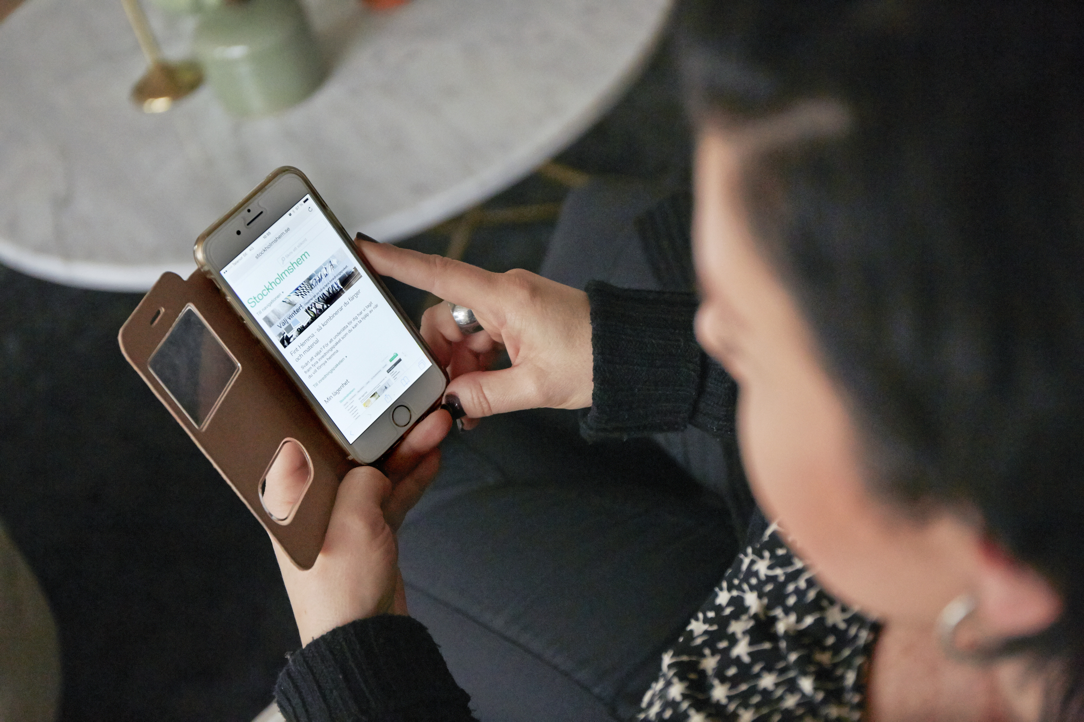
Tenant orders online
Notes:
Leveransrum för hgs varor – levereras med cykel

Slide 3
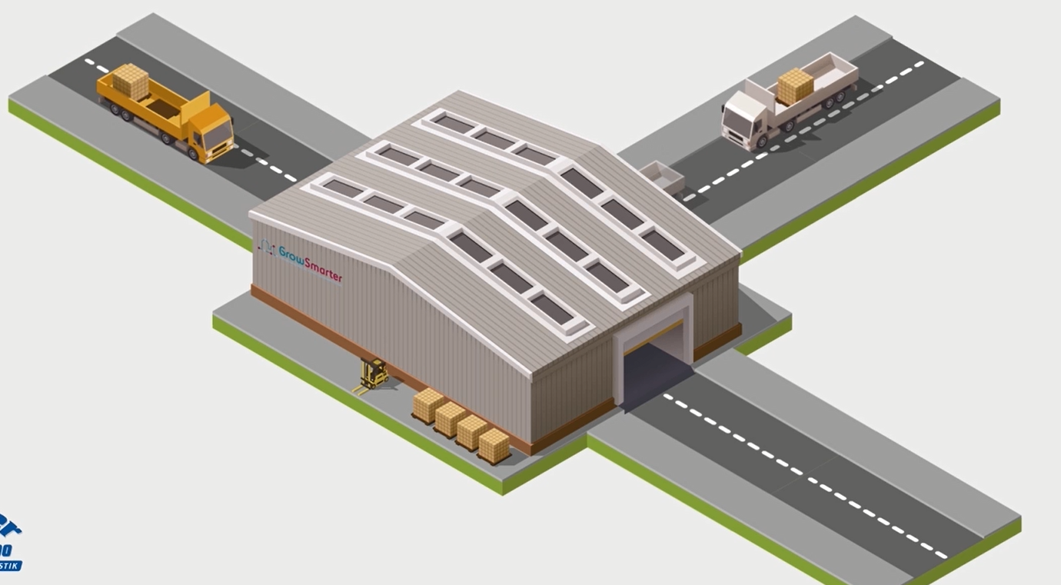
Logistic center, Carrier

Slide 4
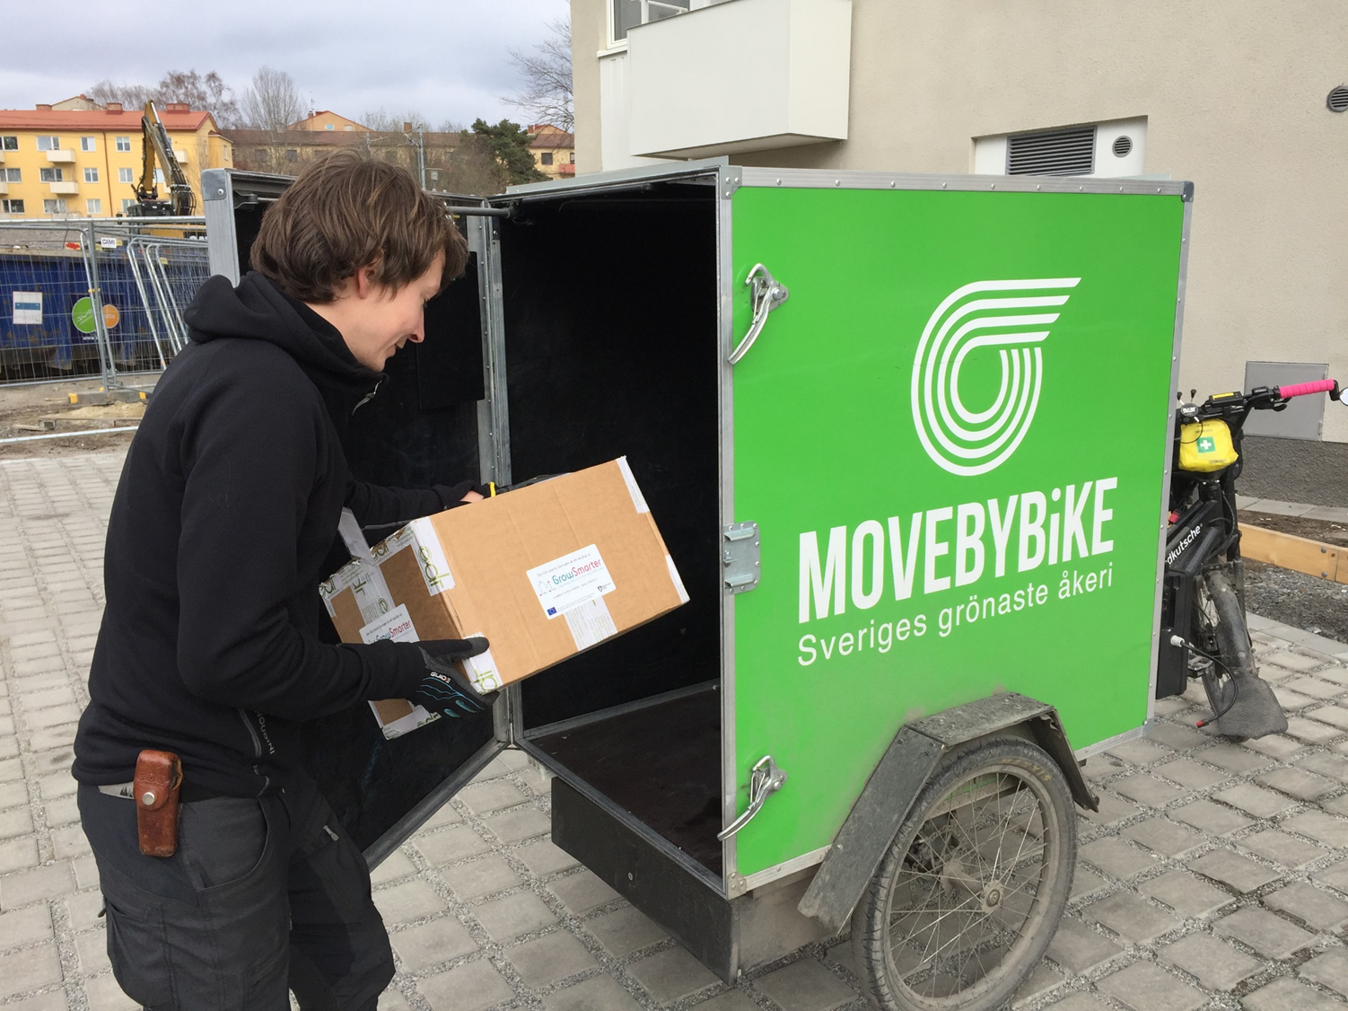
The package is collected, Movebybike

Slide 5
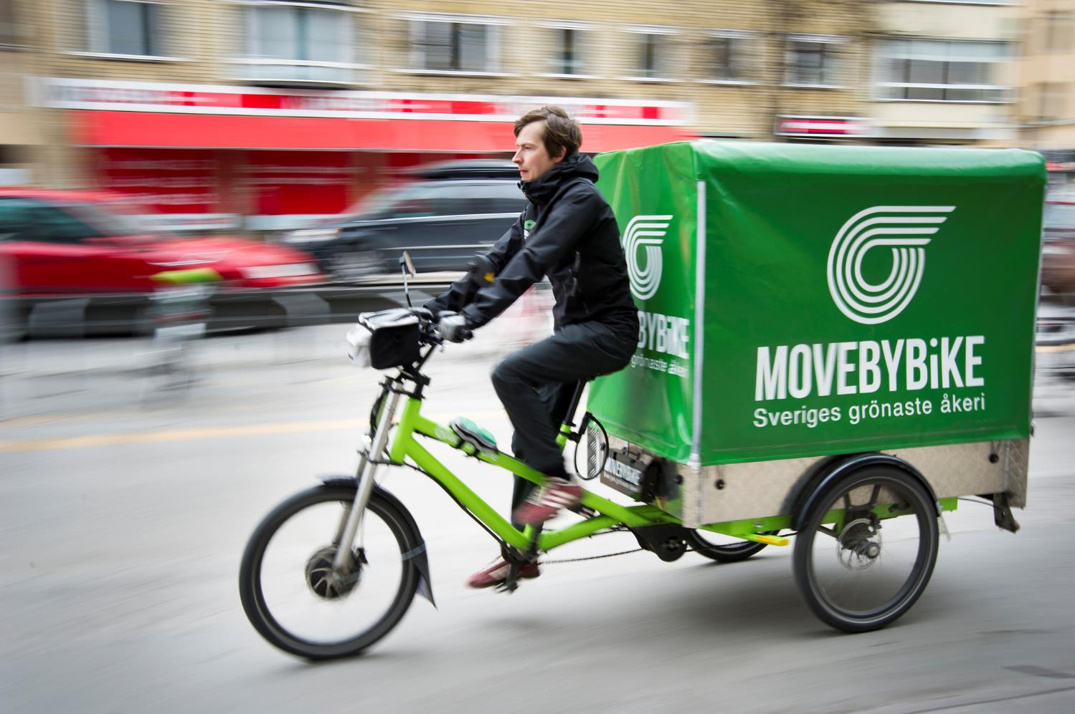
Last mile Delivery by bike, Movebybike
Notes:
Leveransrum för hgs varor – levereras med cykel

Slide 6
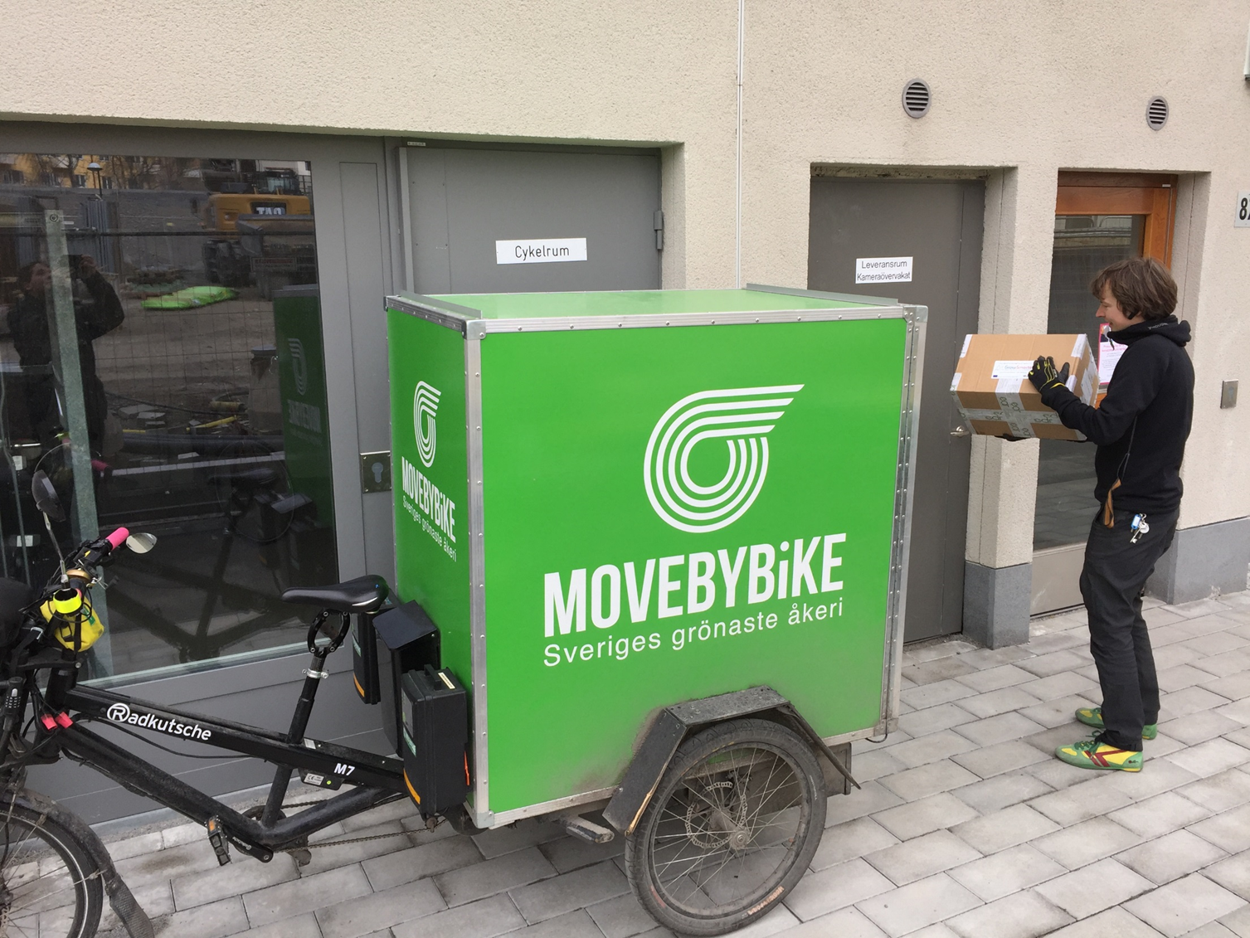
The delivery Room is the residential building, Stockholmshem

Slide 7
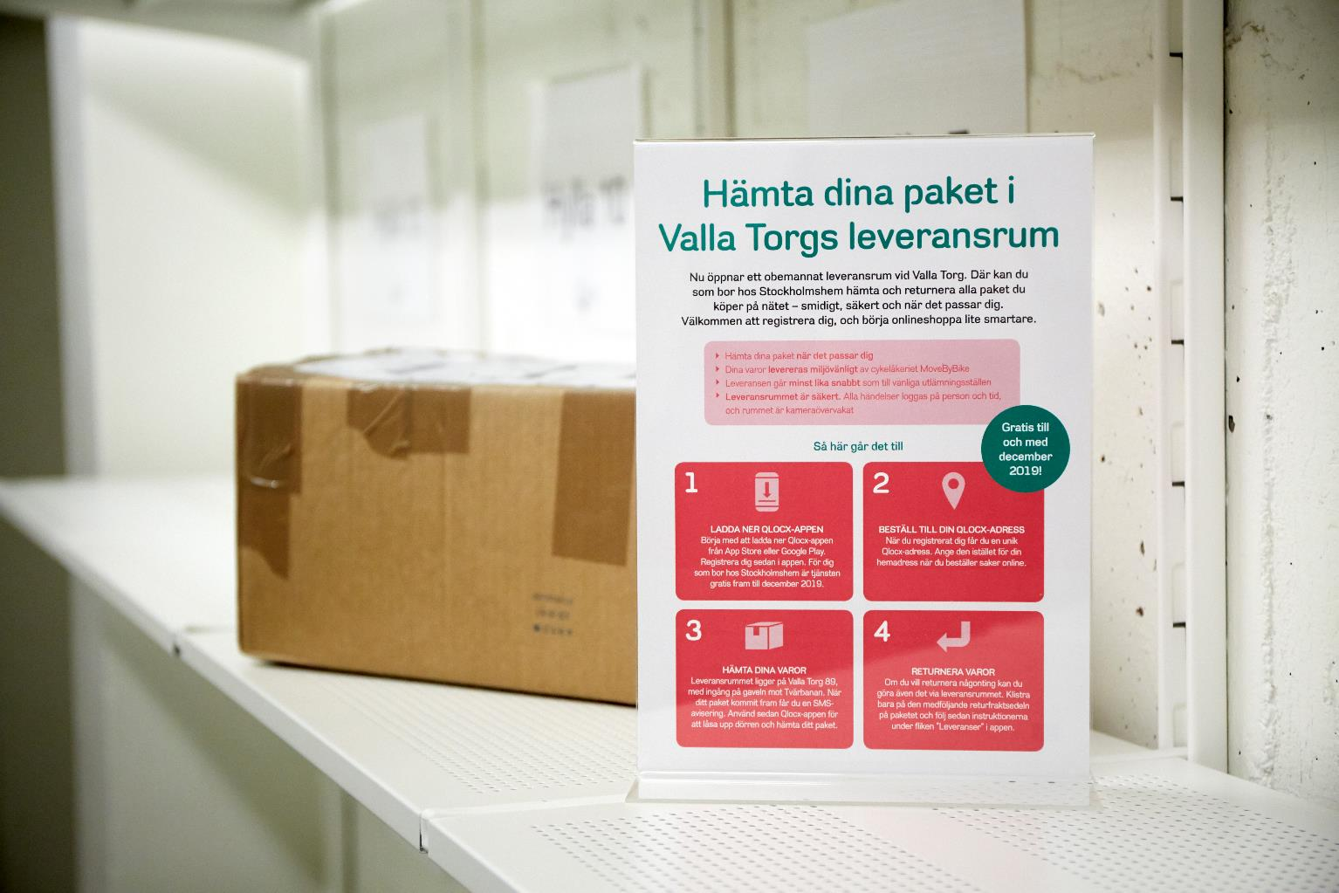
Delivery room, Stockholmshem
Notes:
Leveransrum för hgs varor – öppnade i slutet av mars

Slide 8
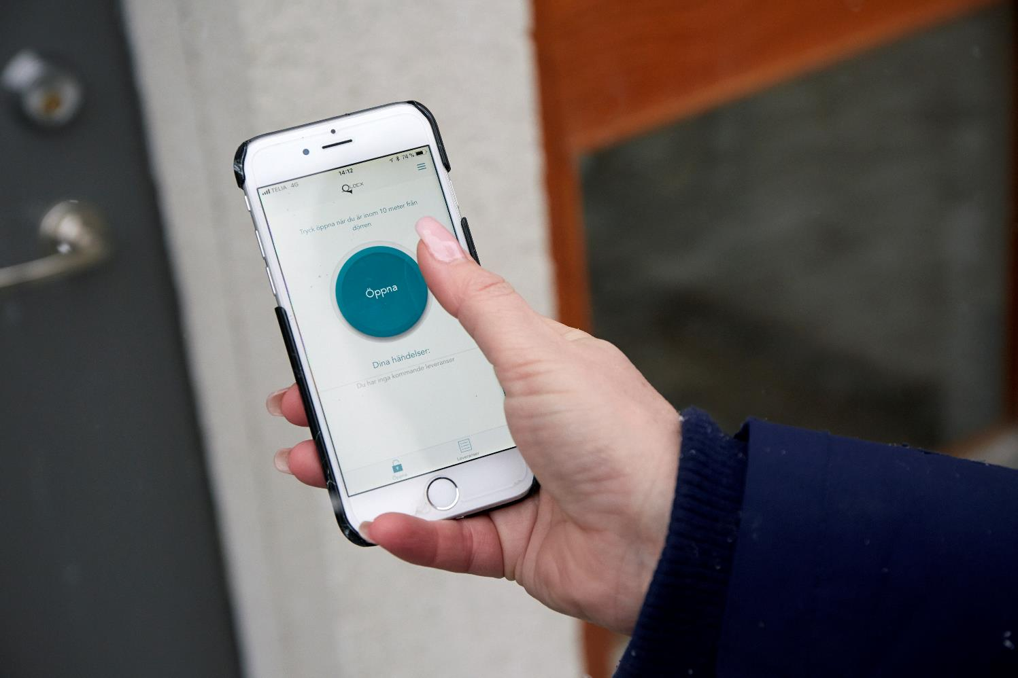
digital key, Qlocx
Notes:
Leveransrum för hgs varor – levereras med cykel

Slide 9
Pickup, TENANT

Slide 10
Return, TENANT

Slide 12
Thank you for your attention!
Lisa Enarsson
Project manager
City of Stockholm lisa.enarsson@stockholm.se

