Slide 1
Bringing together cities & industry to stimulate uptake of smart city solutions
Lisa Enarsson, Coordination Team, City of Stockholm
Notes:
My name is Lisa Enarsson and I am working in the City of Stockholm and I am part of the Coordination team for GrowSmarter – transforming Cities for a smart sustainable Europé - a project that has got EU funding from the Horison 2020 call for SmartCities and Communities. The project brings cities together with Industry to stimulate uptake of smart City solutions. The lighthouse cities where the solutions will be demonstrated are Stockholm, Cologne and Barcelona.

Slide 2
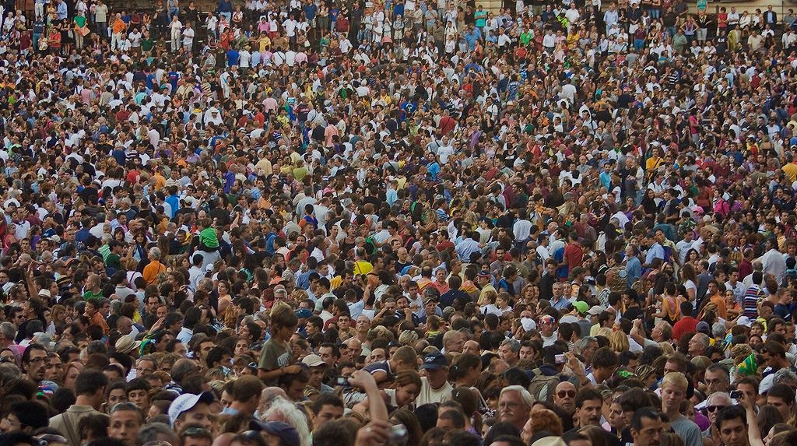
Today cities face similar challenges:
(Climate change, housing, jobs, transportation, waste…)
Notes:
Today cities face very much the same challanges: Climate Change, Housing, Jobs,Transportation, Waste

Slide 3
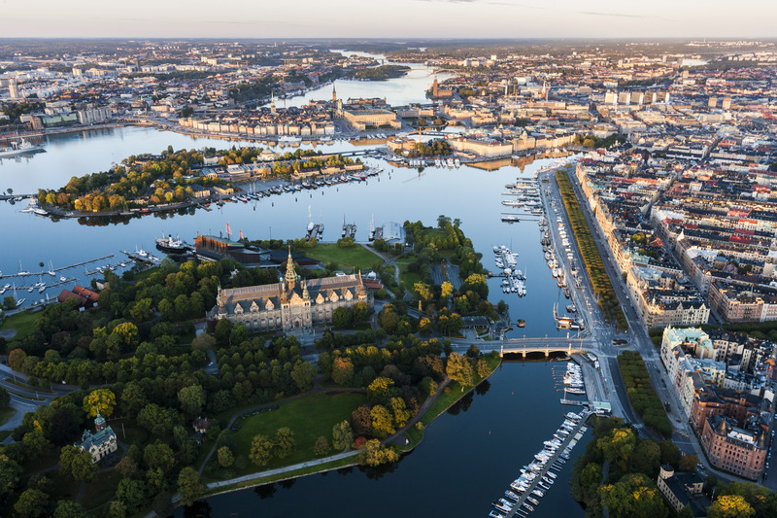
City of Stockholm Goals
- A City for all
- Fossil fule free by 2040
- The smartest city in the world by 2040

Slide 4
Stockholm Goals and achievements
Fossil-Fuel Free
Real Development
Goals
Notes:
The City of Stockholm ha worked hard to reduce GHG emissions since 1990. Now our politicians have set up a goal for Stockholm to be fossilfuel free until 2040. We have reached halfway, but now it starts to get more tricky, so we really need new smart solutions.
Total:
1990: 3,7 Million tons of CO2
2000: 3,6 Million tons of CO2
2005: 3,1 Million tons of CO2
2009: 2,8 Million tons of CO2
2015: 2.4 Million tons of CO2
2020: 1,9 Million tons of CO2

Slide 5
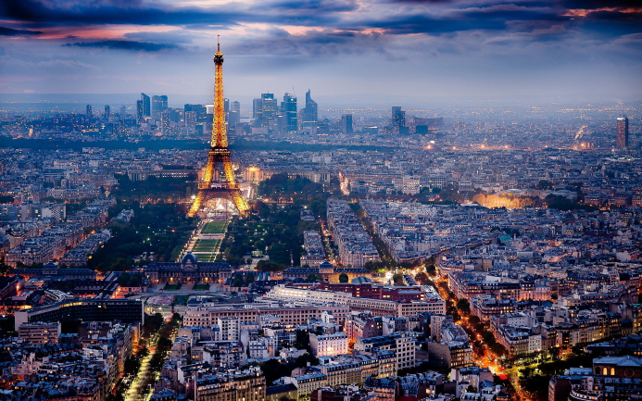
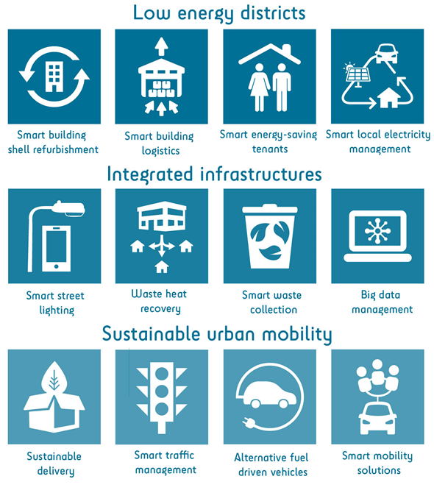
GrowSmarter shows 12 smart solutions!
Economic, social and environmental project targets: Save resources and increase economic growth
Improve quality of life and create 1,500 jobs across Europe
Reduce energy usage by 60 % and cut GHG by 60 %
Notes:
GrowSmarter demonstrates 12 solutions that most cities can use, contributing to solve the City challanges and to reach the project targets to save resourses and increase economic growth, improve the quality of life and create jobs and Reduce Energy use and Green House Gas emissions.
The smart solutions are divided into three themes: Low Energy Districts, Integrated Infrastructure and Urban Mobility. In Stockholm many of the solutions are developed in a new built ecodistrict with ambitious sustainability targets, called the Royal Seaport, and through GrowSmarter the solutions will be used in excisting areas.

Slide 6
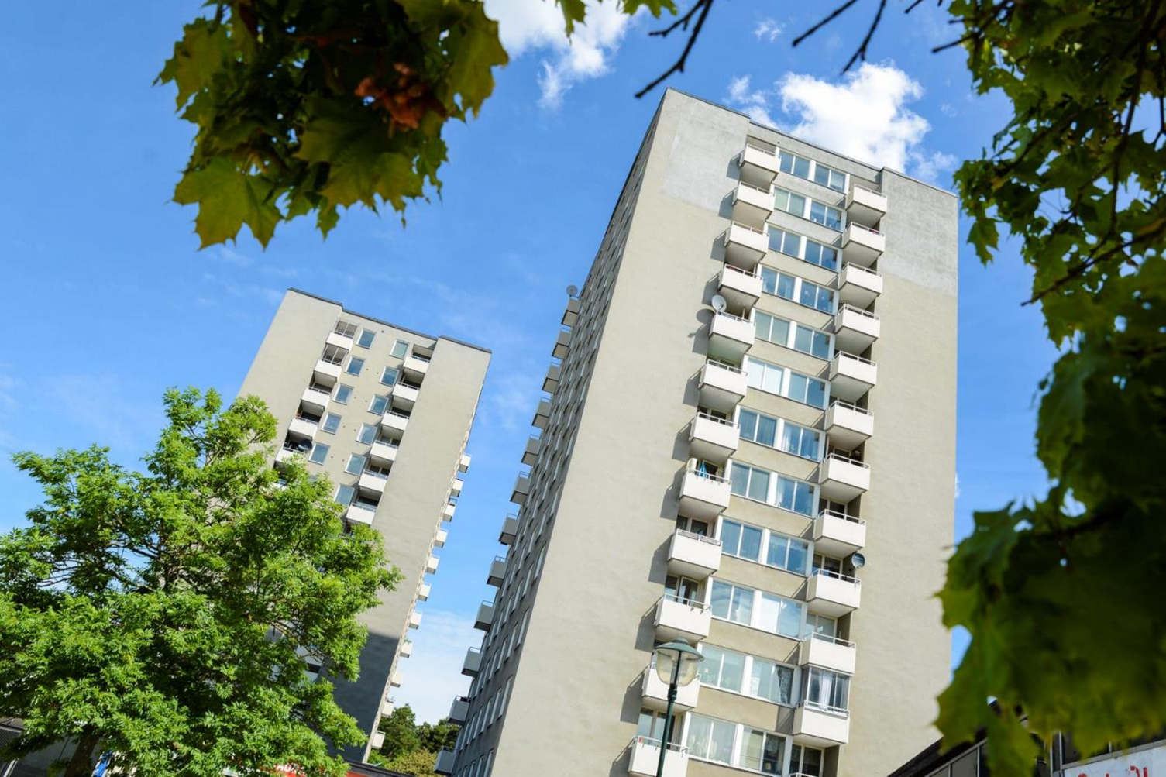
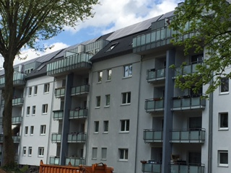
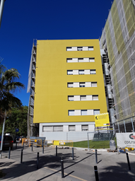
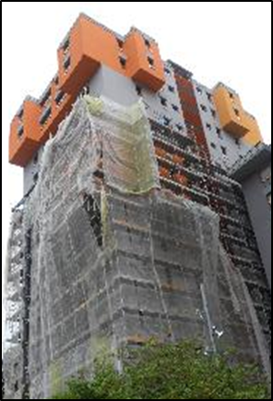
12 Smart Solutions – Low Energy Districts
Efficient and smart climate shell refurbishment (S,C,B)
Windows with extra low U-values, 0,7, with quadruple glazing
Reducing hot water losses
Recovering heat from drainage water
Efficient lighting
Additional insulation on outer walls and roof
Smart heating, cooling and ventilation systems
New energy efficient elevators
Notes:
The main focus of the project is Energy efficient refurbishment. In Europe around 40 % of the Energy is used in Buildings. Its important that new buildings are built energy efficient but that is not enough, to reach the Paris Agreements we need to lower the energy used in existing buildings. One third of Europe’s housing stock was built between 1950 and 1970. In GrowSmarter we are refurbishing these older buildings using new construction techniques and the amount of energy they use is calculated to be reduced by 60-70 percent.
Windows with extra low U-values, 0,7, with four glas layers
Reducing hot water losses
Recovering heat from drainage water
Efficient lighting
Additional insulation on outer walls and roof
Smart heating, cooling and ventilation systems
New energy efficient elevators
30-40 percent of goods in Cities are Construction Goods. A centralized logistics center in Stockholm will help cut emissions associated with these. The material will be stored and distributed just in time when they are needed and also avoiding many different heavy vehicles into the constructions site. Transports into the construction site will be done by hybrid-electric, ethanol or biogas fuelled vehicles which will also help reduce emissions.
Providing information on real-time energy usage and waste levels to tenants is a key tool to help them see and reduce their own environmental footprint. Using this information in pricing will mean that the biggest polluters pay the most, providing further incentives for residents to reduce waste and cut energy consumption.
Home Energy Management Systems
Open home net
Energy Visualisation
Individual energy metering
For renewable energy to be really reliable, it can’t be dependent on changing weather conditions. By investing in local energy production and storage, the cities will build local energy systems and even out peaks and drops in demand.
Virtual Power Plant

Slide 7
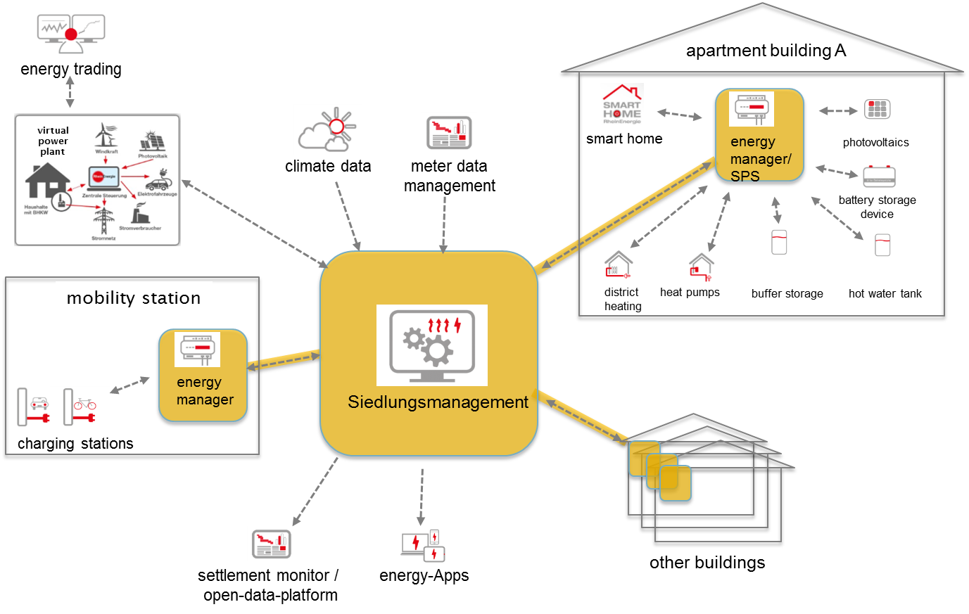
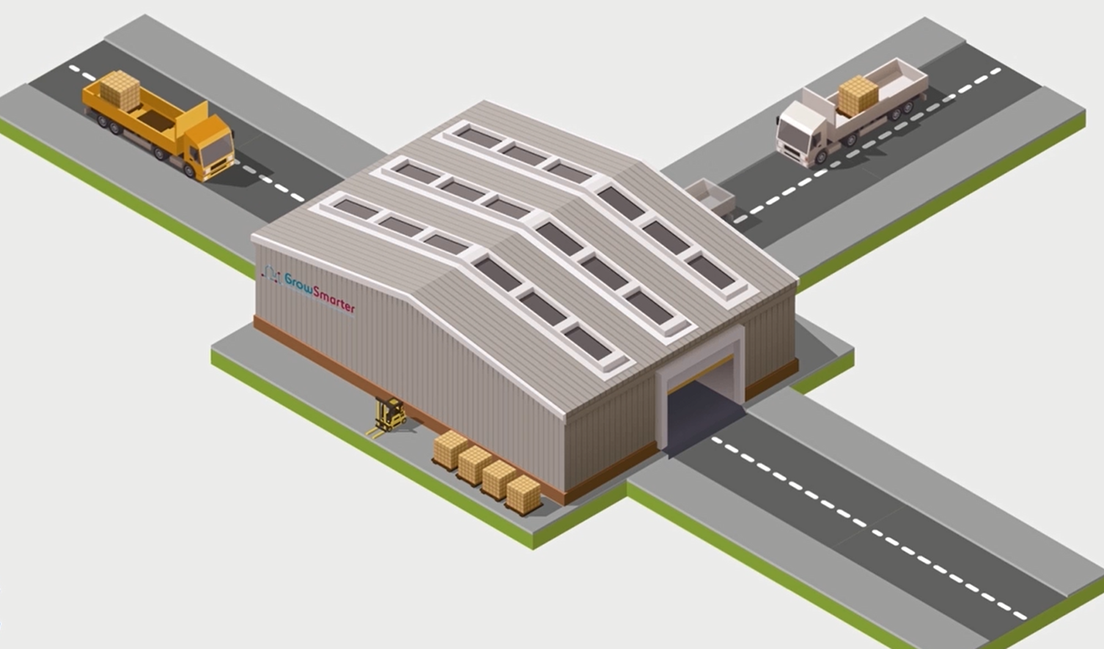
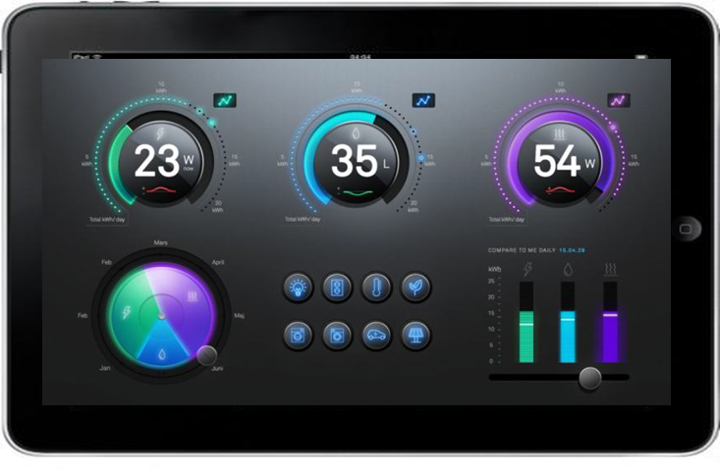
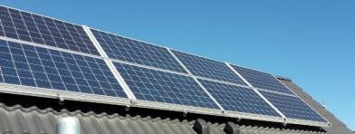
12 Smart Solutions – Low Energy Districts
Efficient and smart climate shell refurbishment (S,C,B)
Smart building logistics with alternative fueled vehicles (S)
Smart energy tenants through information (S,C,B)
Smart local production of electricity and integration with buildings and grid (S,C,B)
Notes:
30-40 percent of goods in Cities are Construction Goods. A centralized logistics center in Stockholm will help cut emissions associated with these. The material will be stored and distributed just in time when they are needed and also avoiding many different heavy vehicles into the constructions site. Transports into the construction site will be done by hybrid-electric, ethanol or biogas fuelled vehicles which will also help reduce emissions.
Providing information on real-time energy usage and waste levels to tenants is a key tool to help them see and reduce their own environmental footprint. Using this information in pricing will mean that the biggest polluters pay the most, providing further incentives for residents to reduce waste and cut energy consumption.
Home Energy Management Systems
Open home net/Active home
Energy Visualisation
Individual energy metering
For renewable energy to be really reliable, it can’t be dependent on changing weather conditions. By investing in local energy production and storage, the cities will build local energy systems and even out peaks and drops in demand.
Virtual Power Plant in Cologne

Slide 8
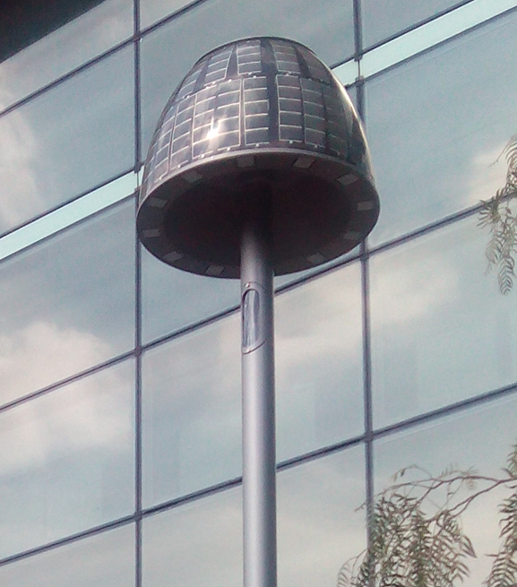
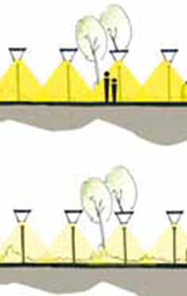
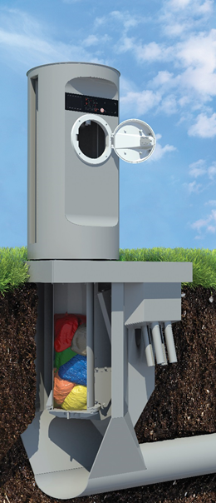
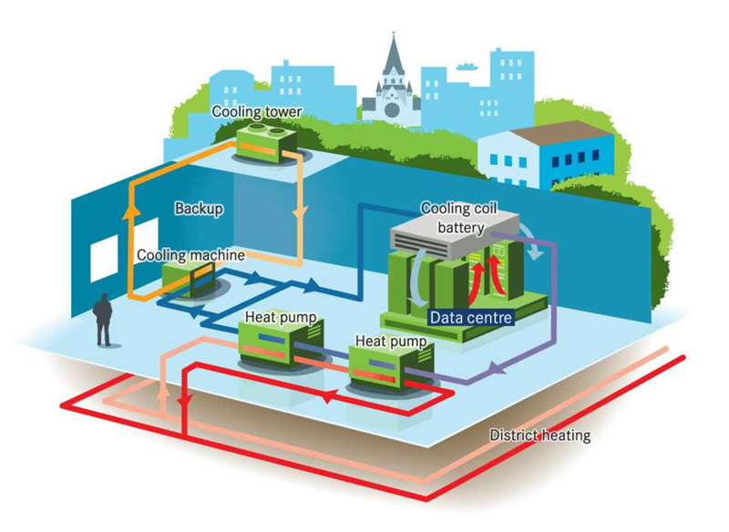
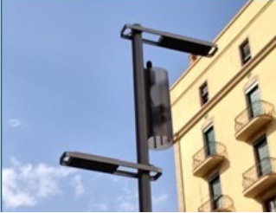
12 Smart Solutions – Integrated Infrastructure
Smart lighting, lamp and traffic posts as hubs for communication (S,C,B)
Waste heat integration by new business models (S,B)
Smart waste collecting, turning waste to electricity, heat and biogas for vehicles (S)
Notes:
Street lighting keeps urban centres safe, but traditional lampposts consume huge amounts of energy. Combining energy efficient LED bulbs with motion sensors so the light will be to dimmed when nobody is around and brighten up as people approach will save 50 % of the energy used. In addition lampposts and other traffic poles will be used as communications hubs.
Smart street lighting
Traffic posts as a base for sensors
The Facebook data center (120 MW) in Luleå use 1 TWh of electricity per year and the waste heat is not recovered. The heat is enough for heating around 100 000 apartments.
In the Open district heating solution Fortum will recover waste heat from one data center (1 MW) and one supermarkets and reusing it to heat around 1000 apartments. By letting district heating operators buy excess heat and sell it on, the heating production costs can be brought down, and the data center or Supermarket will be payed for their waste heat. It is a win-win solution.
Sometimes, what’s needed is a simple solution. Separating waste into different coloured bags makes it quick and easy to sort. One in-let and one pipe saves space and when vacuum technology is used to suck the bags through underground tubes, waste trucks are avoided in urban areas. The coloured bags are optically sorted.
Open data platforms can help cities collect and analyse data patterns for essential city activities such as traffic management, communications and infrastructure. This information can then be used to take decisions about future investments. Key performance indicators will allow the cities to monitor their overall environmental performance on an ongoing basis.
Big open data platform

Slide 9
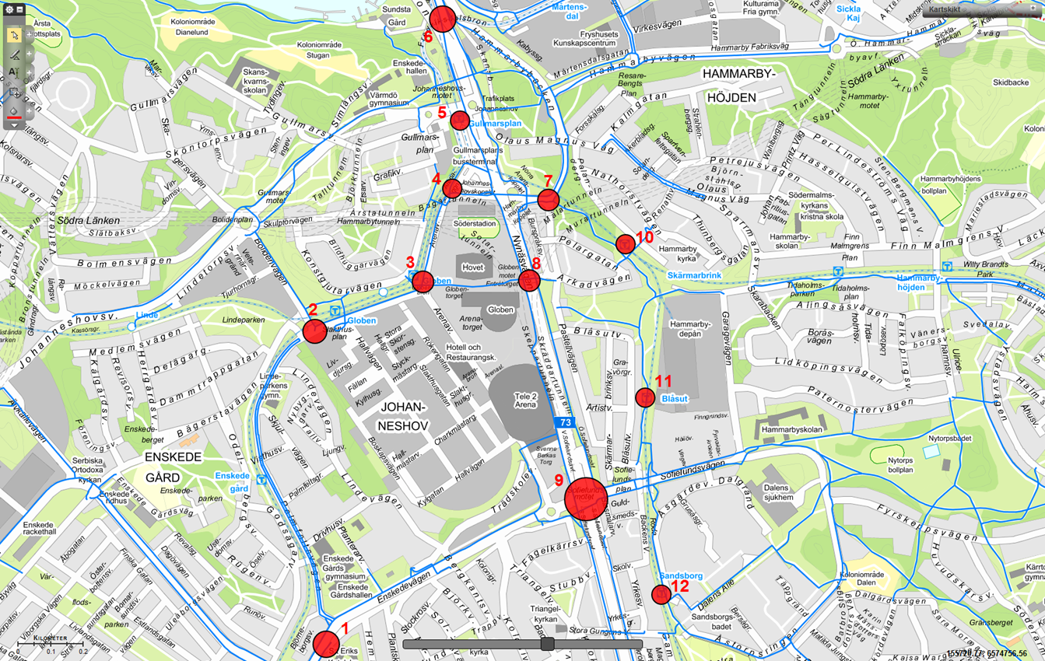
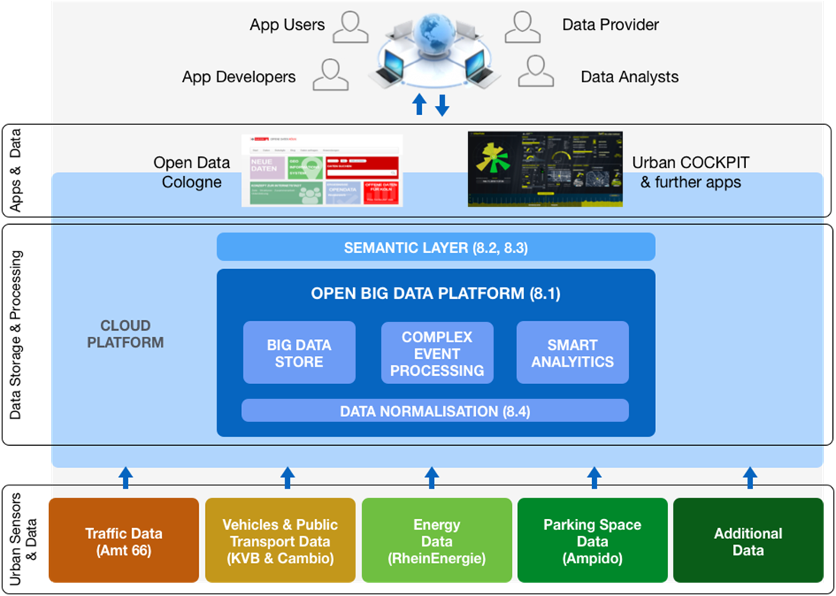
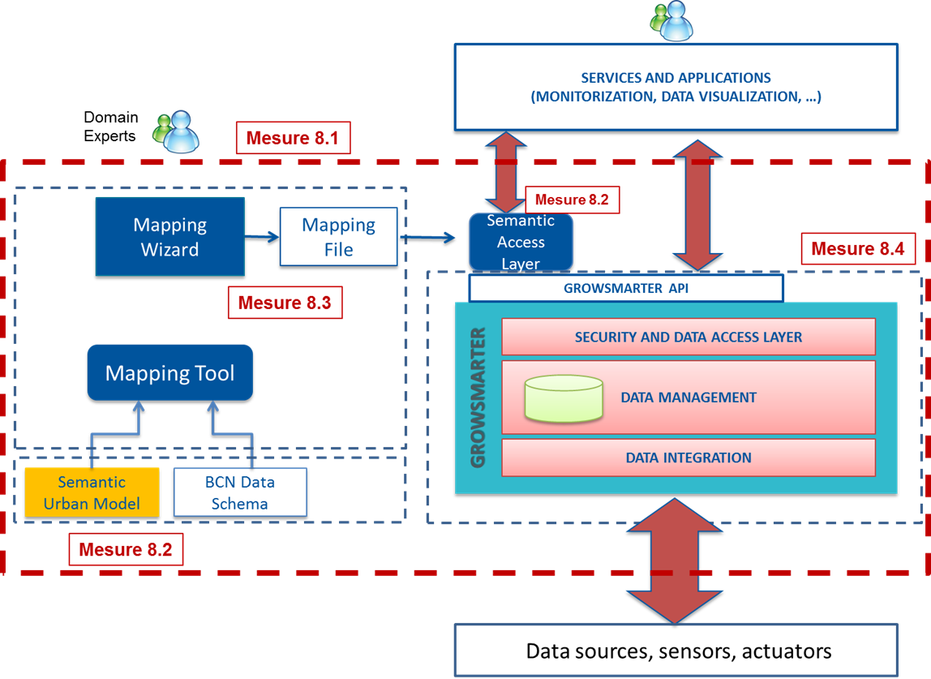
12 Smart Solutions – Integrated Infrastructure
Smart lighting, lamp and traffic posts as hubs for communication (S,C,B)
Waste heat integration by new business models (S,B)
Smart waste collecting, turning waste to electricity, heat and biogas for vehicles (S)
Big data protocol for saving energy and improving the quality of life (S,C,B)
Notes:
Street lighting keeps urban centres safe, but traditional lampposts consume huge amounts of energy. Combining energy efficient LED bulbs with motion sensors so the light will be to dimmed when nobody is around and brighten up as people approach will save 50 % of the energy used. In addition lampposts and other traffic poles will be used as communications hubs.
Smart street lighting
Traffic posts as a base for sensors
The Facebook data center (120 MW) in Luleå use 1 TWh of electricity per year and the waste heat is not recovered. The heat is enough for heating around 100 000 apartments.
In the Open district heating solution Fortum will recover waste heat from one data center (1 MW) and one supermarkets and reusing it to heat around 1000 apartments. By letting district heating operators buy excess heat and sell it on, the heating production costs can be brought down, and the data center or Supermarket will be payed for their waste heat. It is a win-win solution.
Sometimes, what’s needed is a simple solution. Separating waste into different coloured bags makes it quick and easy to sort. One in-let and one pipe saves space and when vacuum technology is used to suck the bags through underground tubes, waste trucks are avoided in urban areas. The coloured bags are optically sorted.
Open data platforms can help cities collect and analyse data patterns for essential city activities such as traffic management, communications and infrastructure. This information can then be used to take decisions about future investments. Key performance indicators will allow the cities to monitor their overall environmental performance on an ongoing basis.
Big open data platform

Slide 10
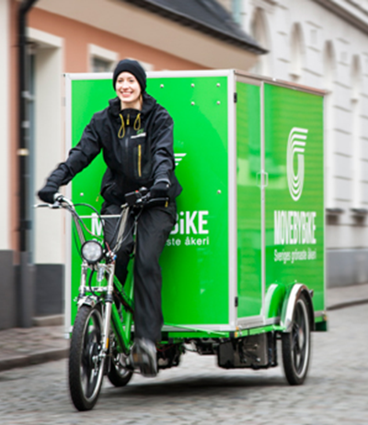
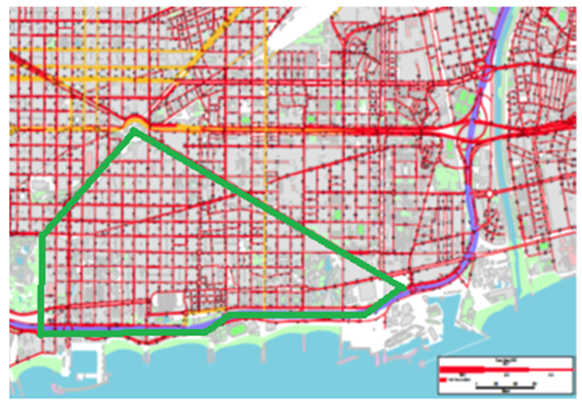
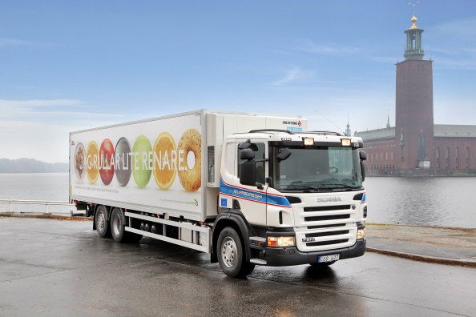
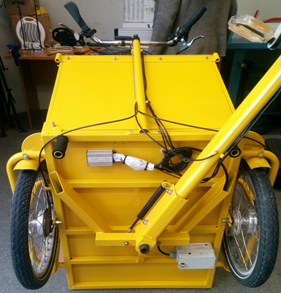
12 Smart Solutions – Urban Mobility
Sustainable delivery (S,B)
Smart traffic management (S,B)
Notes:
The popularity of online shopping has led to more delivery trucks visiting residential areas increasing emissions, noise levels and traffic hazards. Smarter, integrated deliveries will cut overall traffic and provide better information on delivery times, while the use of cleaner vehicles will help to reduce local pollution levels.
Integrated multi-mode transport for light goods
Congestion in cities is a major source of delay and frustration as well as increasing pollution levels and damaging air quality. Smart management of Traffic lights communicating with cars so they can adapt their speed to reach green lights and signal priority for electric and renewable fuelled delivery trucks will be tested in Stockholm.
Traffic control system for passenger vehicles
Traffic signal synchronisation to help movement of goods

Slide 11
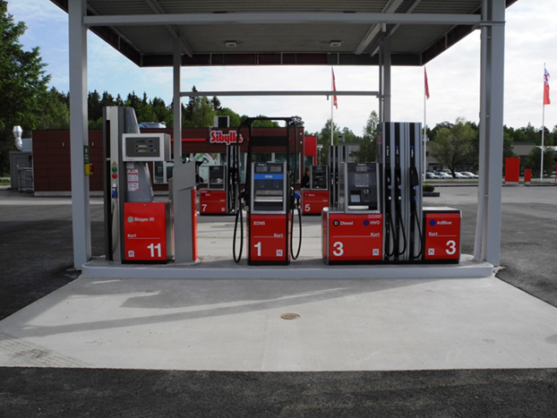
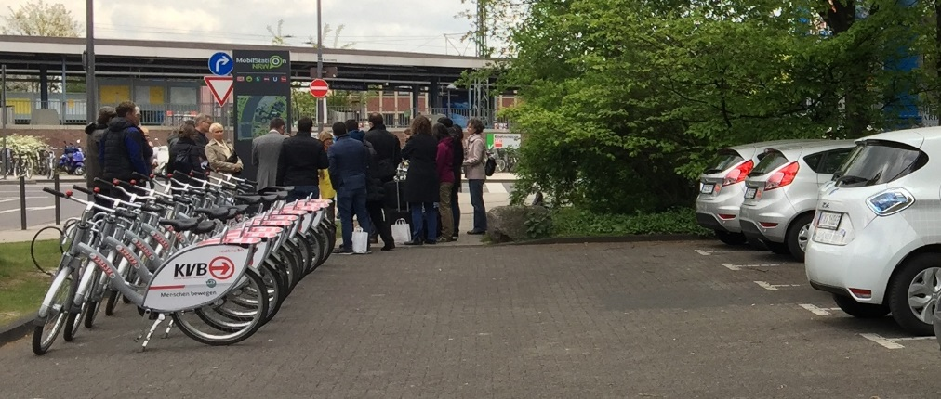
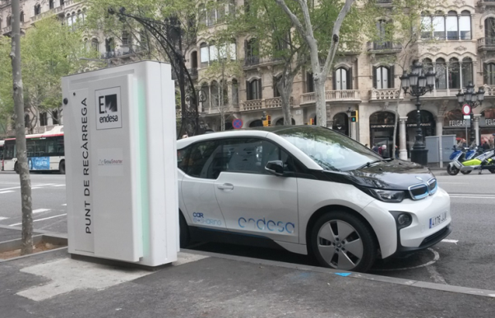
12 Smart Solutions – Urban Mobility
Sustainable delivery (S,B)
Smart traffic management (S,B)
Alternative fuel driven vehicles for de- carbonizing and better air quality (S,C,B)
Smart mobility solutions (S,B,C)
Notes:
A key issue for cars with renewable fuel is the lack of infrastructure to back them up. GrowSmarter will invest in charging points and infrastructure to speed up the switch to alternative fuels.
Developing charging infrastructure
Setting up refueling facilities for alternative heavy duty fuels (biogas, ED 95, HVO, RME)
Smart guiding to alternative fuel stations and fast charging
Public transportion and biking are great for regular commutes. In addition a combination of E-cargo bike pools, carsharing and taxi services facilitates a life without a car of your own.
Green parking index in combination with electric car sharing pool
Electrical and cargo bike pool
Mobility hub
E-motorbike service

Slide 12
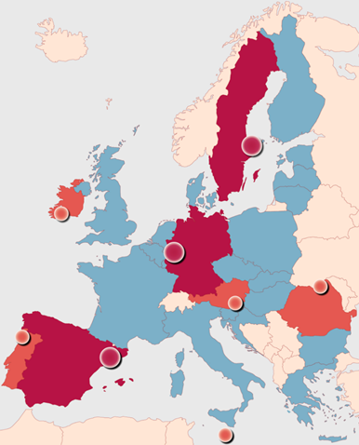
The GrowSmarter project
..aims to demonstrate, validate & roll out the 12 smart solutions to support the transition to a smarter, more sustainable Europe
5. Roll-out in take-up cities
3. Development of Smart Business solutions
1. Demonstrations of smart solutions in Lighthouse Cities
4. Replication in “Follower cities”
Valetta, Suceava, Porto, Cork and Graz
2. Independent validation of smart solutions

Slide 13
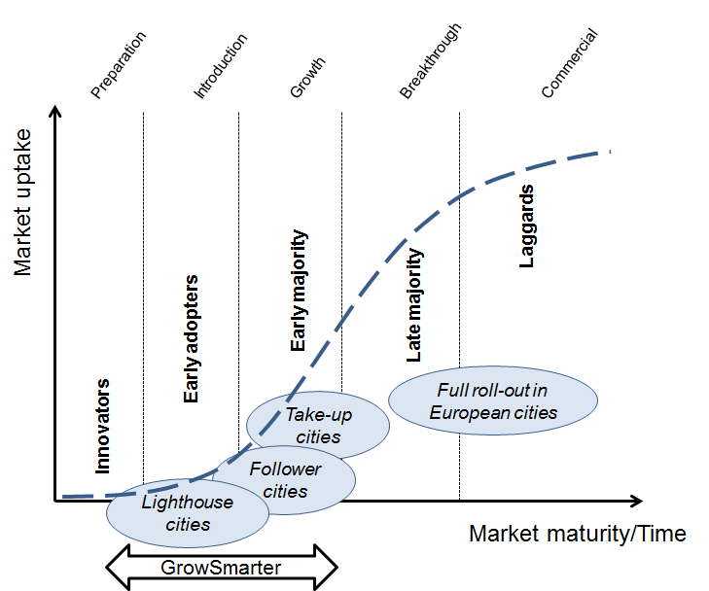
Market Uptake Curve

Slide 14
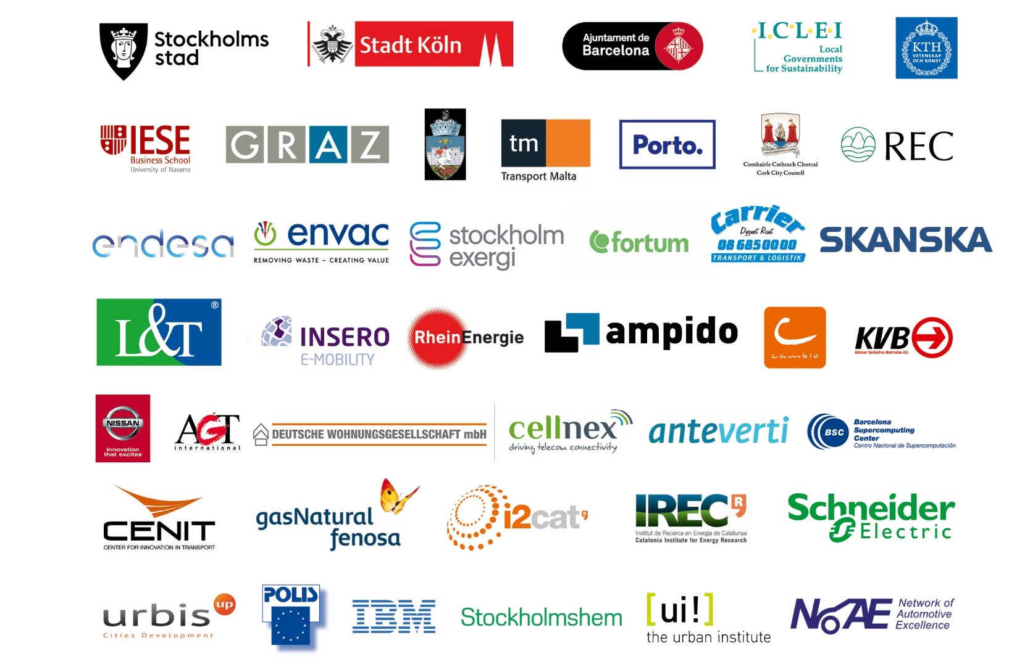

Slide 15
How you and your city can get involved!
The GrowSmarter project is organizing a number of activities…
Join our City Interest Group and become a Take Up City
Take part in our European Workshops and Webinars
- Barcelona 15 November 2018 and November 2019
- Cologne June 2019
- Stockholm May/June and November 2019
Meet our industrial partners
Sign up online for our latest updates or follow us on Twitter @EUGrowSmarter
Find out more about the 12 smart solutions by visiting our website

Slide 16
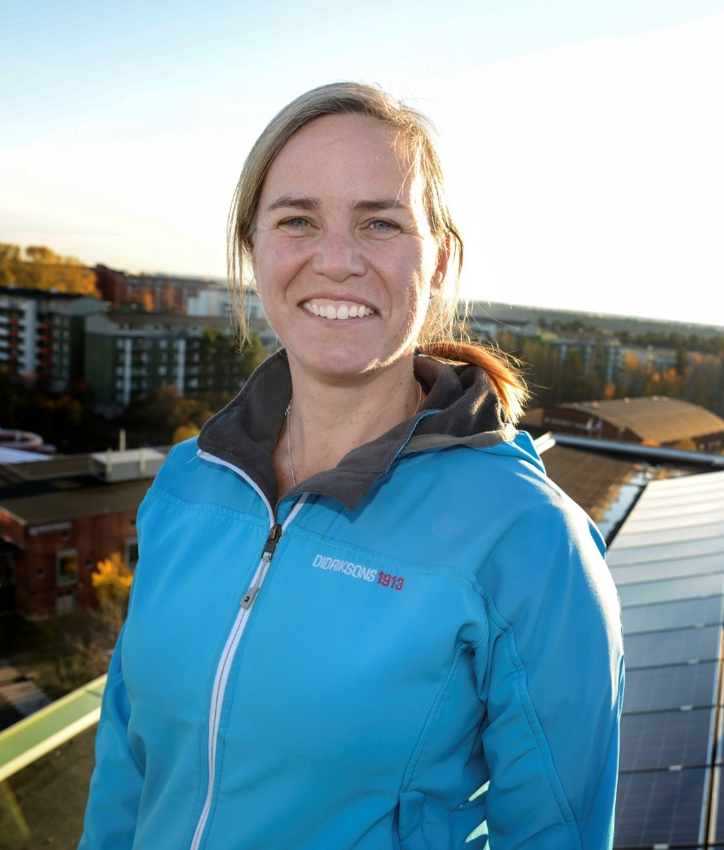
Thank you for your attention!
Lisa Enarsson
Project manager
City of Stockhollm lisa.enarsson@stockholm.se

