Slide 1
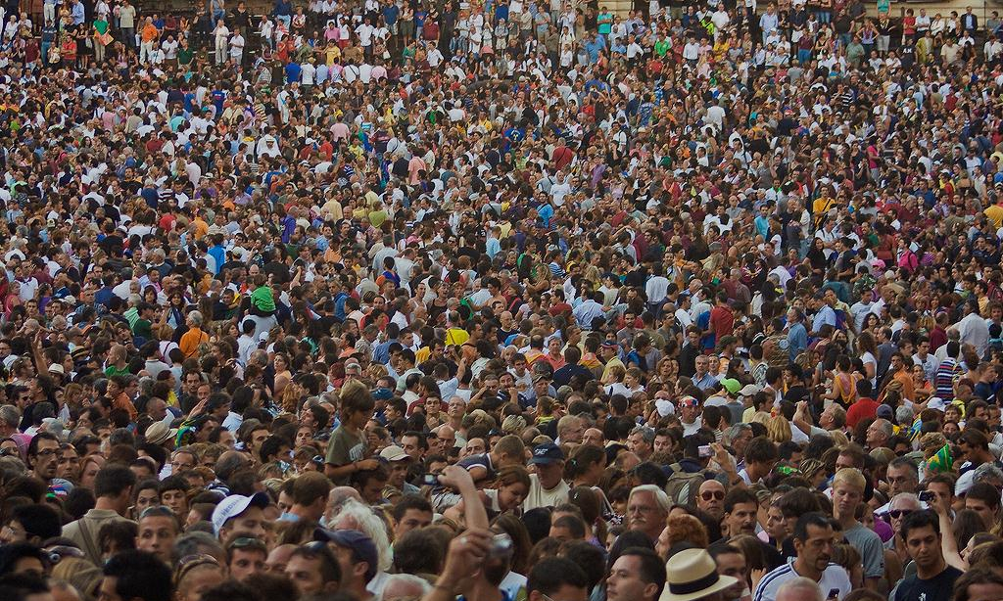



GROWSMARTER
Stockholm, Barcelona, Cologne
Urban Mobility Solutions - Cologne
Julia Egenolf
Climate Protection Office, City of Cologne
Follower City Replication Workshop in Suceava
04. October 2018

Slide 2
Urban Mobility - Bike Sharing Systems
Stockholm, Barcelona, Cologne
Contents
Introduction
Cologne Mobility Overview
Mobility Stations Cologne
Roll-out & Conclusions
Q + A

Slide 3
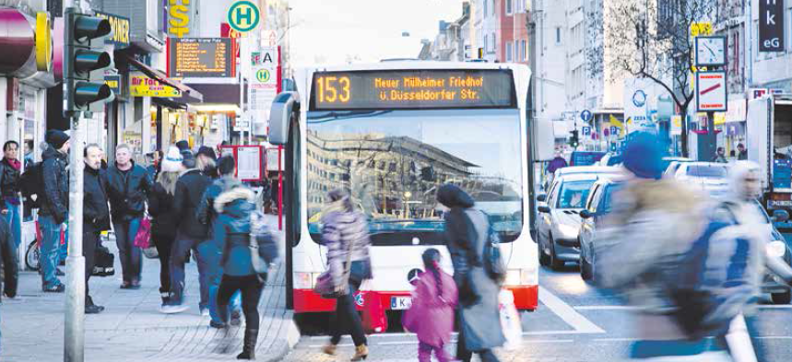
Cologne Urban Mobility Solutions - Overview

Slide 4

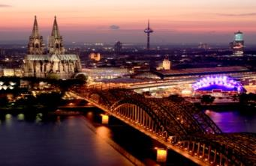
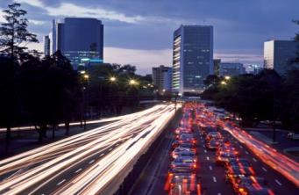
GrowSmarter overview - the integrated project approach
Energy & Mobility & Integrated Infrastructure
12 smart solutions
Low energy districts
Smart building shell refurbishment
Smart building logistics
Smart energy-saving tenants
Smart local electricity management
Waste Heat Recovery
ICT
Integrated Infrastructures
5. Smart street lighting
6. Waste heat recovery
7. Smart waste collection
8. Big data management
Energy
Mobility
Sustainable urban mobility
9. Sustainable delivery
10. Smart traffic management
11. Alternative fuel driven vehicles
12. Smart mobility solutions
Notes:
Die Stadt Köln ist beauftragt, die internationale Koordination mit Stockholm und Barcelona zu führen.
Regelmäßige Telefonkonferenzen mit den drei Städten finden in monatlichen Abständen statt.
Integration - each city itself, between cities, strategic platform for development in eu

Slide 5
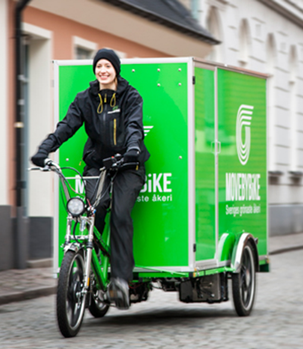
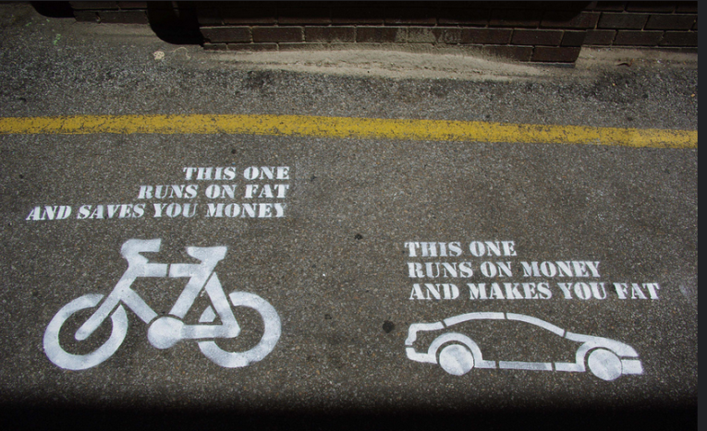
Smart solutions – urban mobility and logistics
  2. Smart building logistics and alternative fuelled vehicles (S)
  Sustainable delivery (S,B)
  Smart traffic management (S,B)
  Alternative fuel driven vehicles for de-carbonising and better air quality (S,C,B)
  Smart mobility solutions (S,B,C)
Notes:
Die Stadt Köln ist beauftragt, die internationale Koordination mit Stockholm und Barcelona zu führen.
Regelmäßige Telefonkonferenzen mit den drei Städten finden in monatlichen Abständen statt.
Integration - each city itself, between cities, strategic platform for development in eu

Slide 6
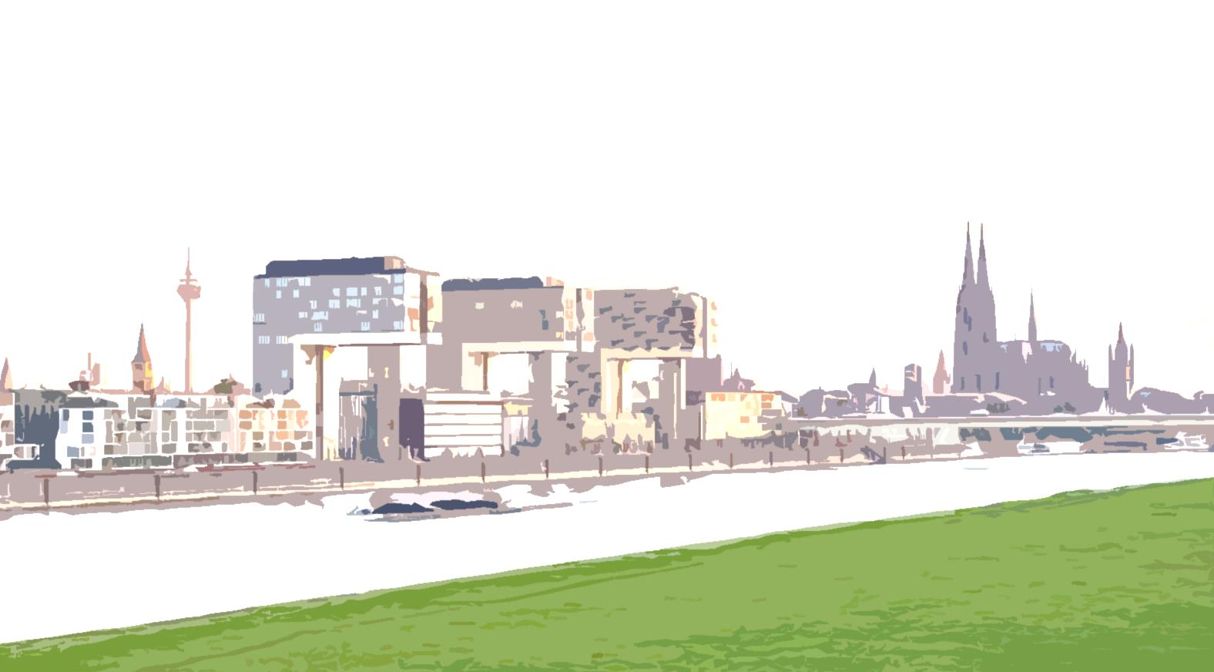
Urban Mobility - Cologne
11.1 Developing charging infrastructure
12.3 Mobility station
12.4 Electrical and conventional car- and bike-sharing

Slide 7
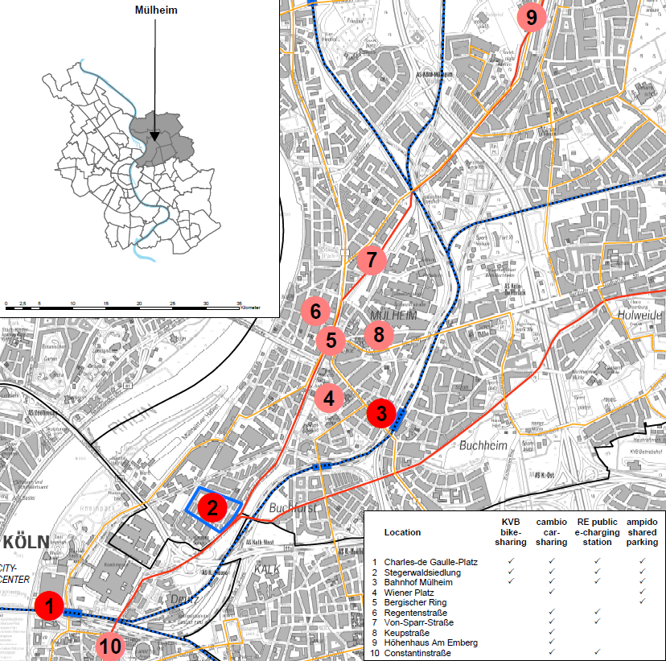
Mobility Stations - Cologne
Goal: CO2reduction by 60 %
Implementation strategy
Reduce traffic search for parking spaces
Reduce privately owned cars
Supply E-mobility
Initialize behavioural change
Less traffic, noise and emissions
© schneider electric

Slide 8




Cologne - Sustainable Urban Mobility
Industrial Partners Cologne
Public Transport & Bike Sharing
Car-Sharing
Local Energy Provider
Parking App

Slide 9
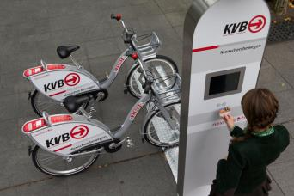
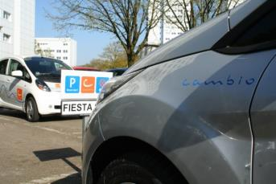
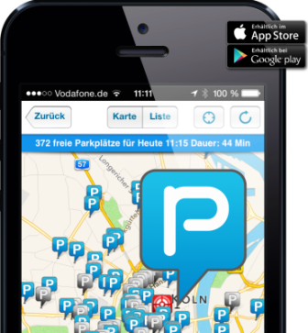
GrowSmarter Cologne
Mobility - Impacts
Bike-sharing / Public Transport
PT-tickets enables people to use PT and bikes all over the city on their way to work for a fair price - all in one ticket, incl. car-sharing
Car-sharing
Users drive 40% less
1 CS-car substitutes 11 privately owned cars - users abolish their cars when starting carsharing
Charging Infrastructure
Charging stations
Parking-sharing - App
Traffic in Cologne consists of approx. 40% traffic from searching for parking space
Reservation of public or private parking spaces
Public law - special permit during project time

Slide 10
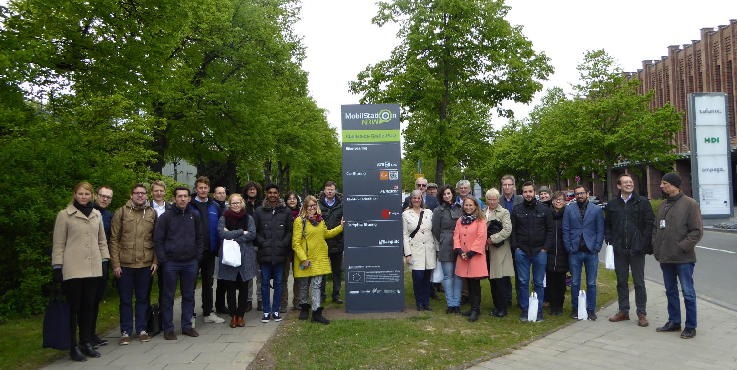
Mobility Station - Cologne
© schneider electric

Slide 11
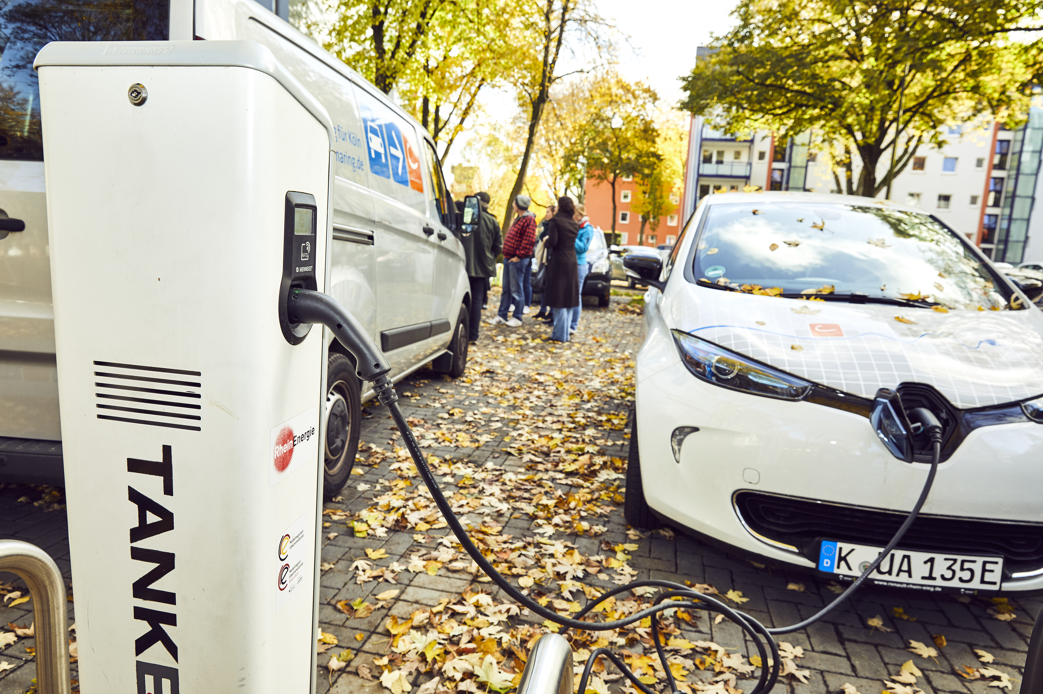
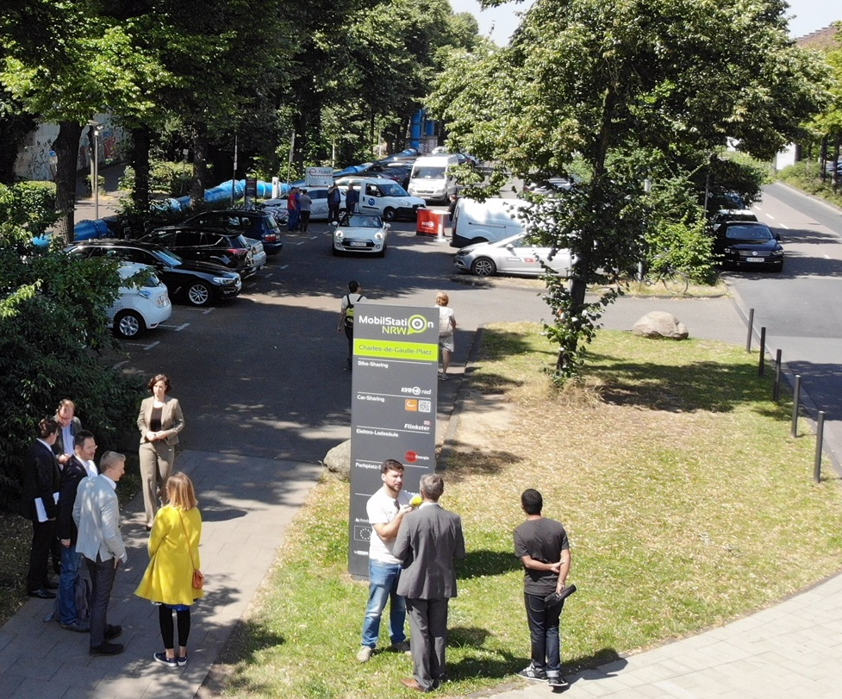
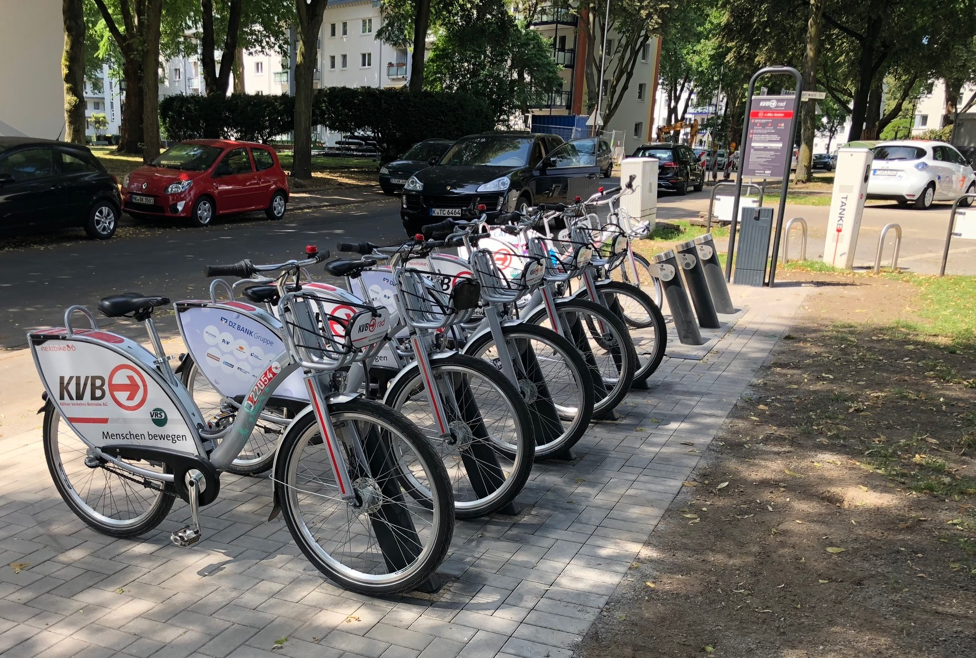
Mobility Station - Cologne

Slide 12

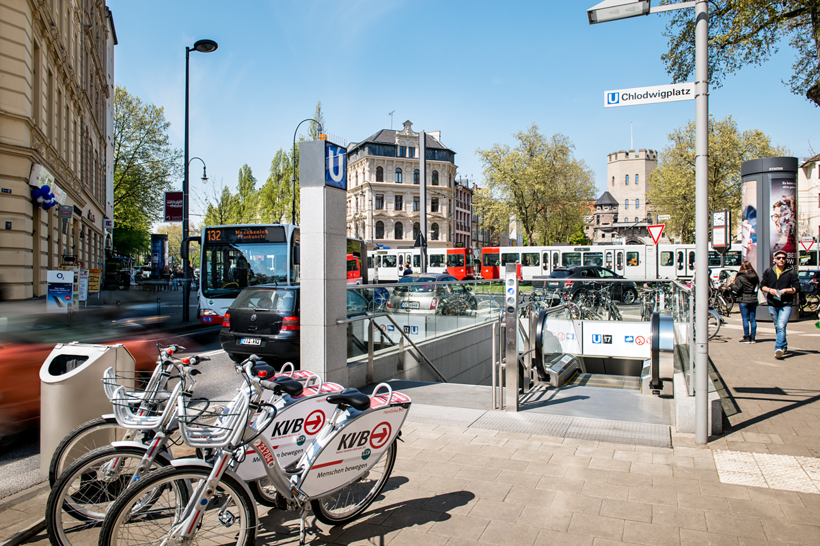
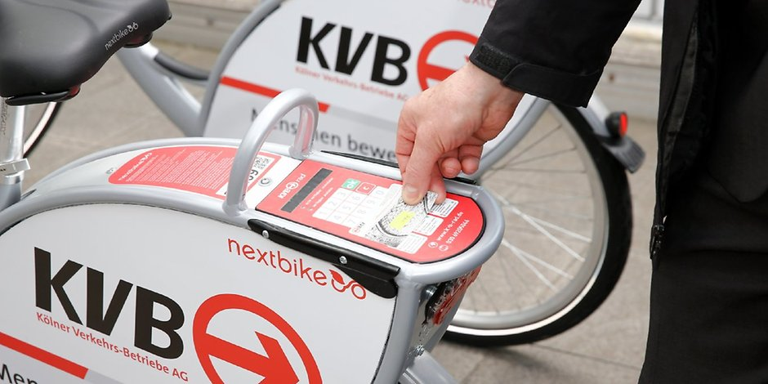
Bike Sharing - Cologne
Bike-sharing system „KVB-Rad“ started in May 2015 as a free-floating-System
Aim: to reinforce the „Umweltverbund“ = mixture of public transport, bike, walking and station-based carsharing & multimodality
Creation of CO2 neutral services
Integration in the VRS-Tariff and creation of a „MultiTicket“ first 30 minutes of each rental are free of charge
Integration of all VRS-Chipcards same access and terms of use for all VRS-clients
Accomodating last mile trips & gaps in public transport
2,6 Mio. rentals since May 2015 and current 1.400 bikes at a Service area of 84 sq km
Approx. 100.000 users
© schneider electric

Slide 13
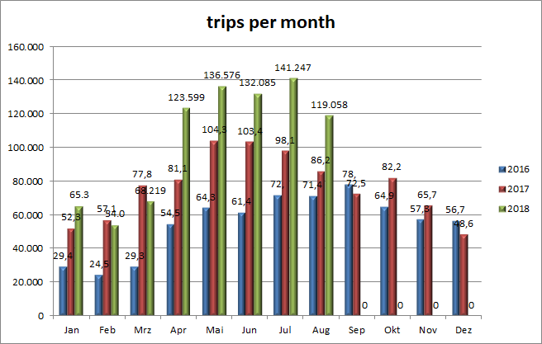
Bike Sharing - Cologne
Status: August 2018: > 2,6 Mio. trips, registered users: > 100.000
Trips per month
© schneider electric

Slide 14
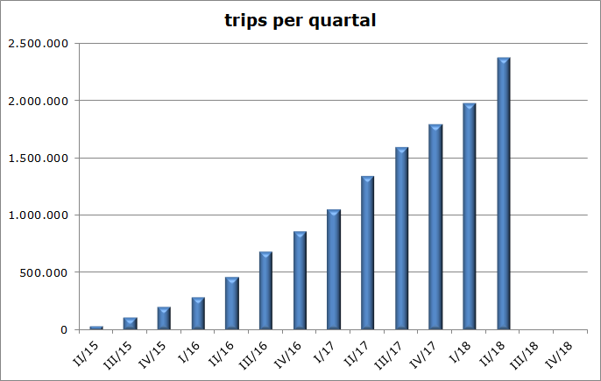
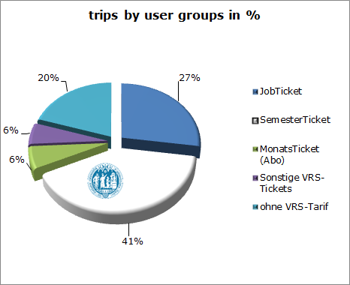
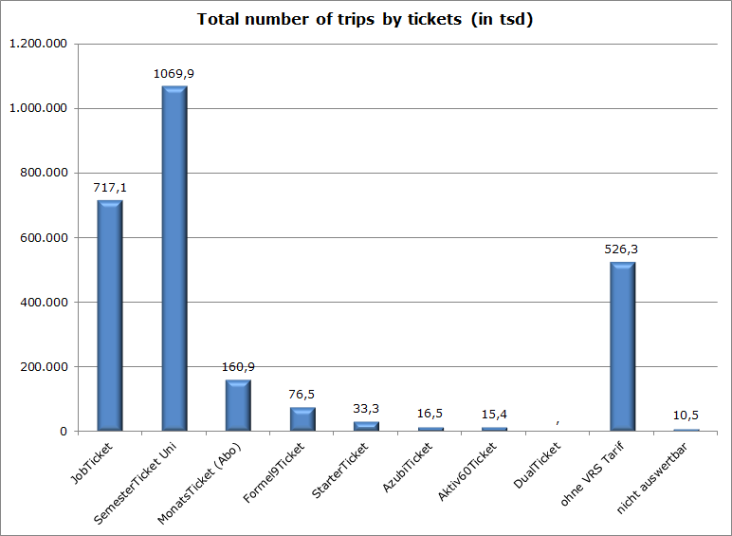
Bike Sharing - Cologne
Increase of trips since May 2015
Approx. 2,6 million trips and a total of 4,16 million km (average trip is 1,6 km)
More than 5.000 rentals per day in the summer
> 70 percent use an e-ticket and are daily commuters
Student- & JobTickets
© schneider electric

Slide 15
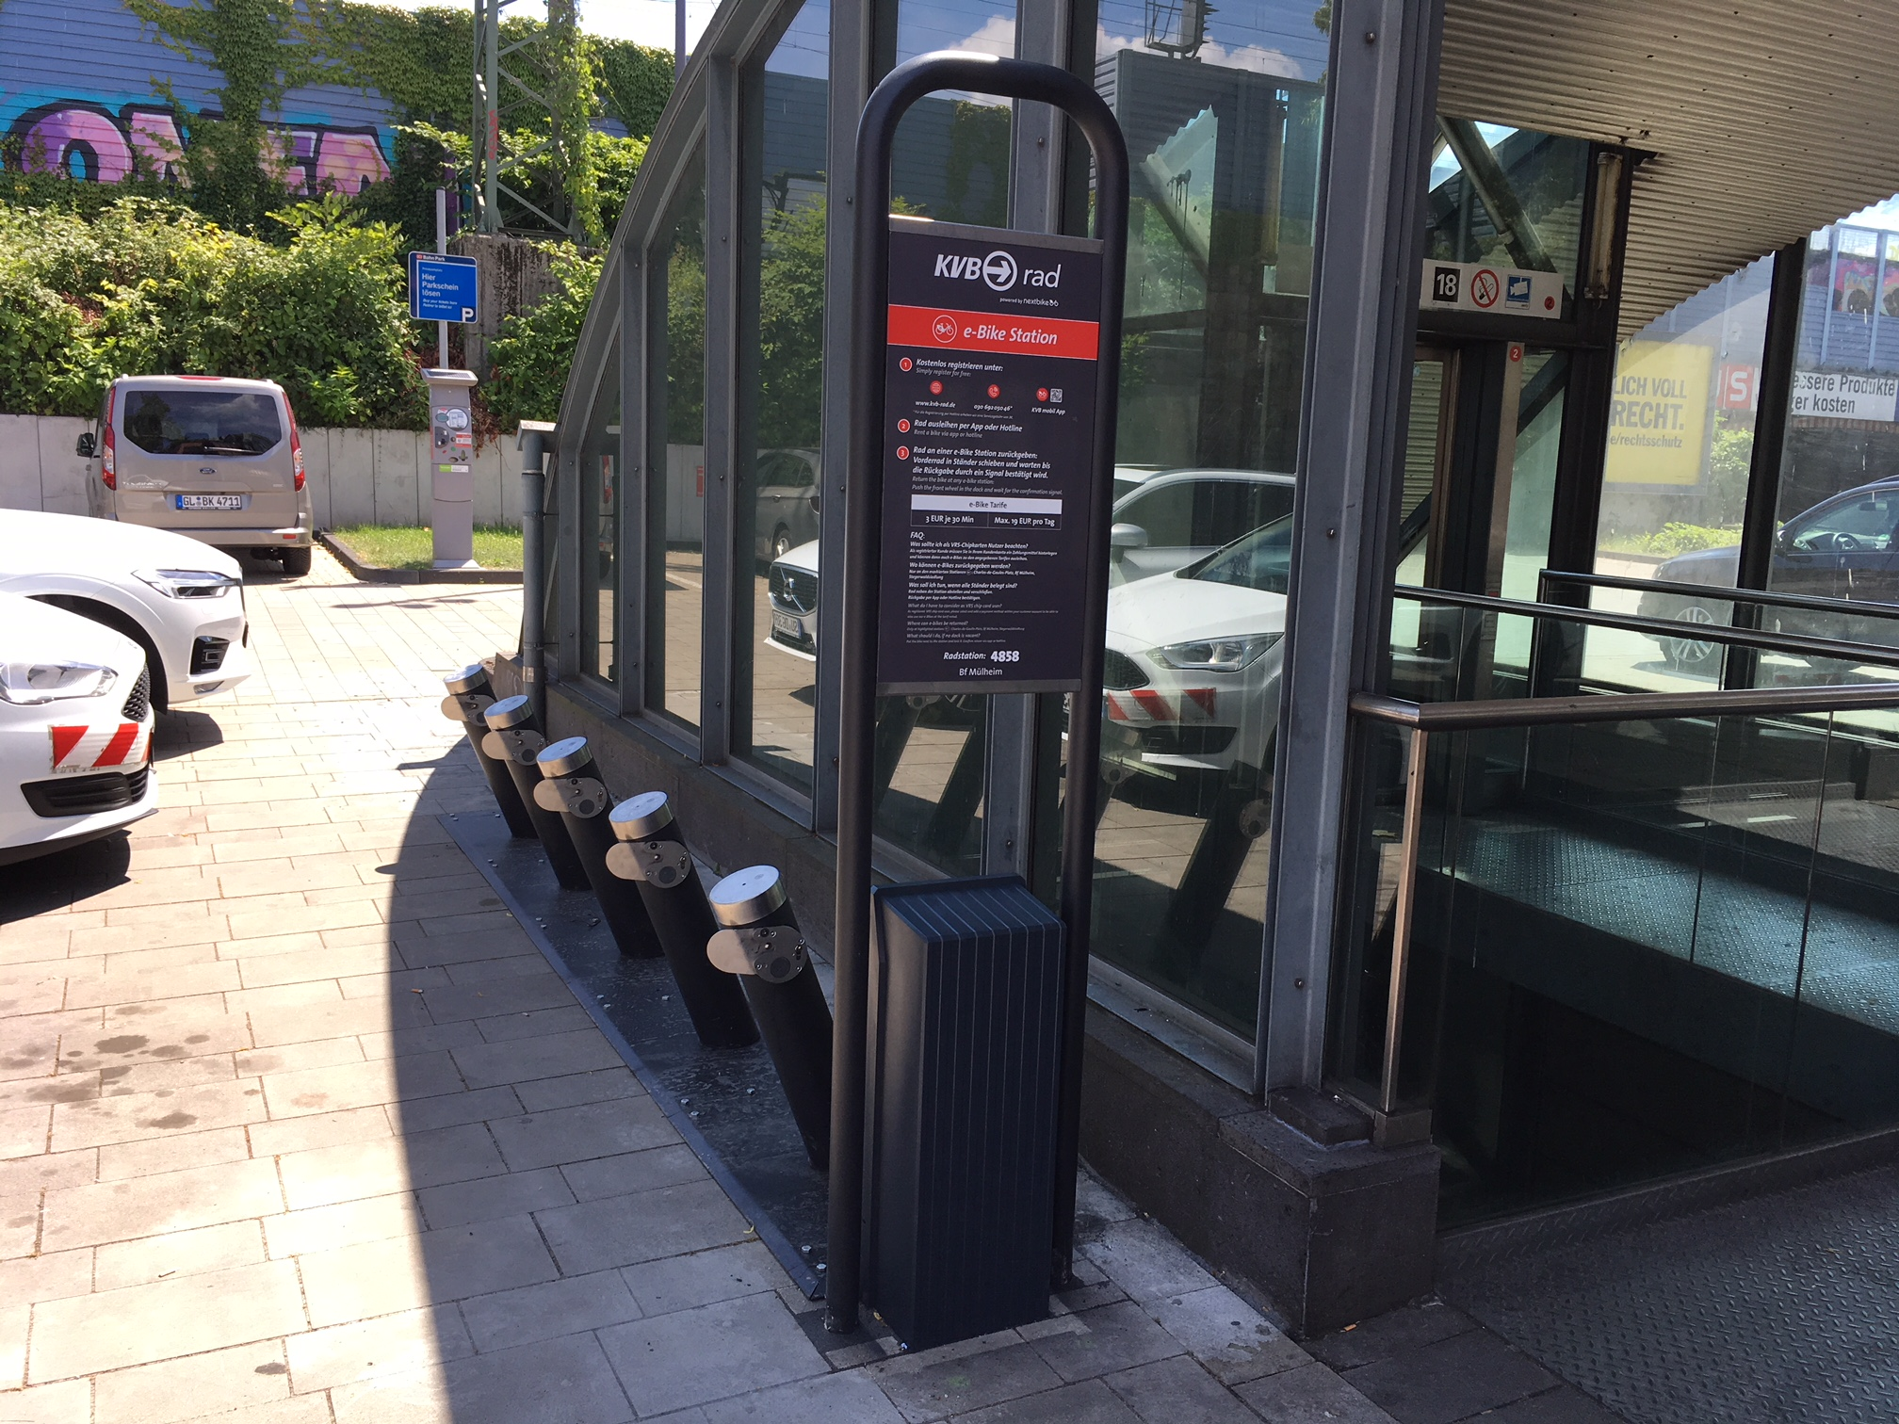
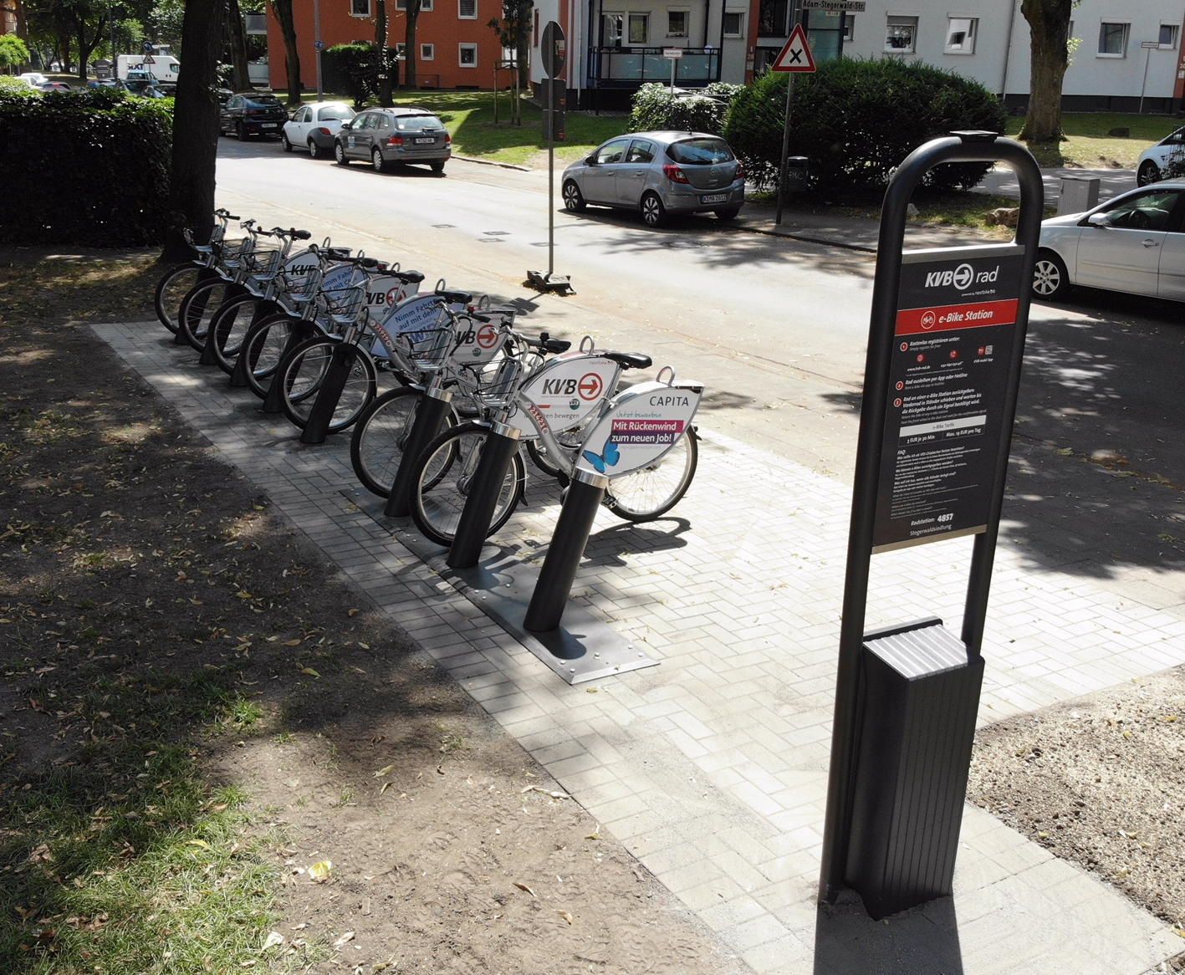
Bike Sharing - Cologne
Testing 10 pedelecs within GrowSmarter until 2019
Station-based mobility stations
> 41.000 CO² neutral km at the seven GrowSmarter mobility stations since 2017
Focus on daily commuter
Average conventional bikes trips is 1.6 km
Together > 4,16 mio. CO² neutral km since May 2015
Question to be answered: how reasonable are pedelecs as a public bike-sharing and are they a new line of business for basic public service?
© schneider electric
Notes:
costs of a Pedelec ~ 3.000 Euros not including infrastructure and operation costs
rental costs: 3 euros per 30 minutes, 19 Euros per day

Slide 16
GrowSmarter Cologne
Mobility Roll-out
Mobility Stations Masterplan for the entire City of Cologne in development
E-Mobility is THE hot topic
Use of data with geographic information systems (GIS) tool to determine locations for mobility stations
Deutsche Post DHL Group‘s quiet and clean parcel delivery with green energy fed electric cars & scooters in Cologne
Potential use of street scooters for city administration
Currently more than 135 charging stations with over 220 charging points, 2 of which are fast charging
11 charging stations for E-bus
11 charging stations for 33 boats
City Council decision to implement 400 spaces for EVs on public lands by 2020
© schneider electric

Slide 17
Bike Mobility Roll-out & Conclusions - Cologne
Conclusions:
Emergence of new actors and services complicated but may help diversification of mobility services
Rules concerning use of public land and administrative processes are barriers to rapid transition
Regulations may not be adapted to support e-vehicles/ alternative fuels
Possible solutions:
Address structural barriers to implementation through e.g. fast-track planning and permitting processes
Involve residents in strategic planning of mobility services
© schneider electric

Slide 18
Thank you for your attention!

Slide 19
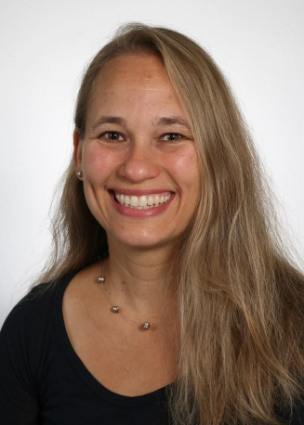

Julia Egenolf
Tel +49 - 221 - 221- 29571
E-Mail julia.egenolf@stadt-koeln.de

